Slide 1

Oracle Data Science
for MoH & Healthcare Researchers
Jakarta, August 1, 2025

Slide 2
Outline
1
Create Session
2
Connect to Object Storage
2
Connect to Oracle Autonomus Database 23ai

Slide 3
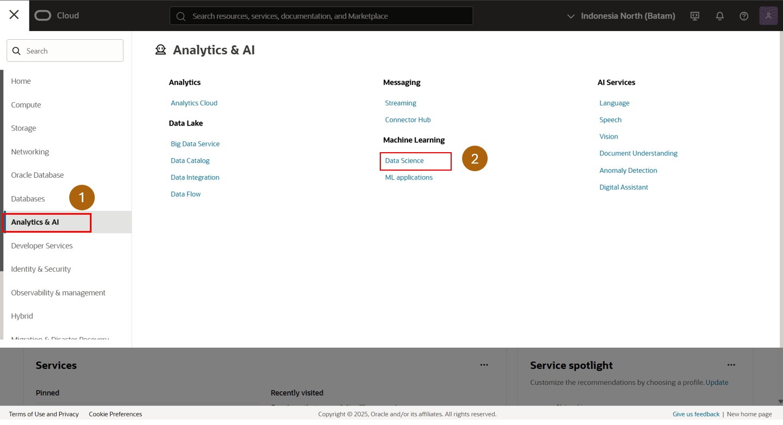
Select Analytics & AI
Select Data Science

Slide 4
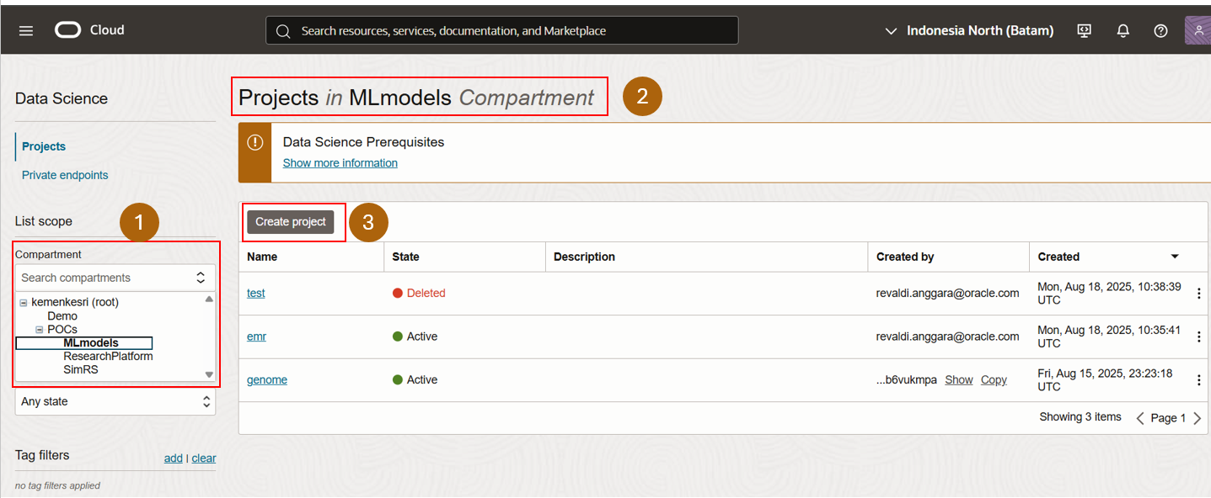
Choose Compartment
Make sure compartment is correct
Create Project

Slide 5
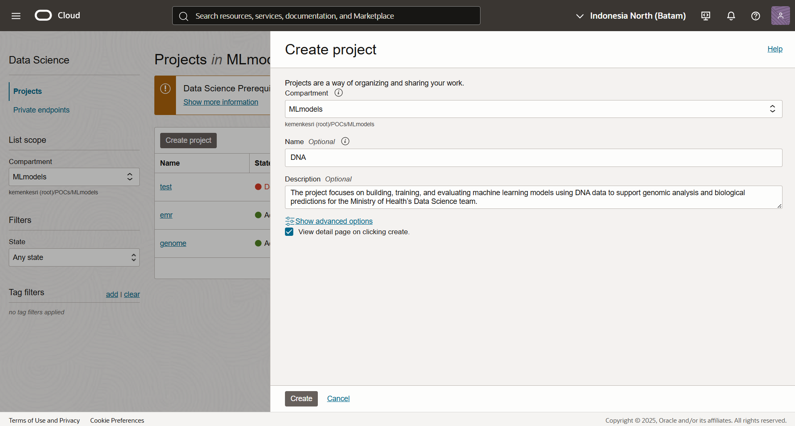
1
2
3
To create a project,
select the correct Compartment (e.g., MLmodels),
enter a Project Name and
an optional Description to provide details about the project.

Slide 6
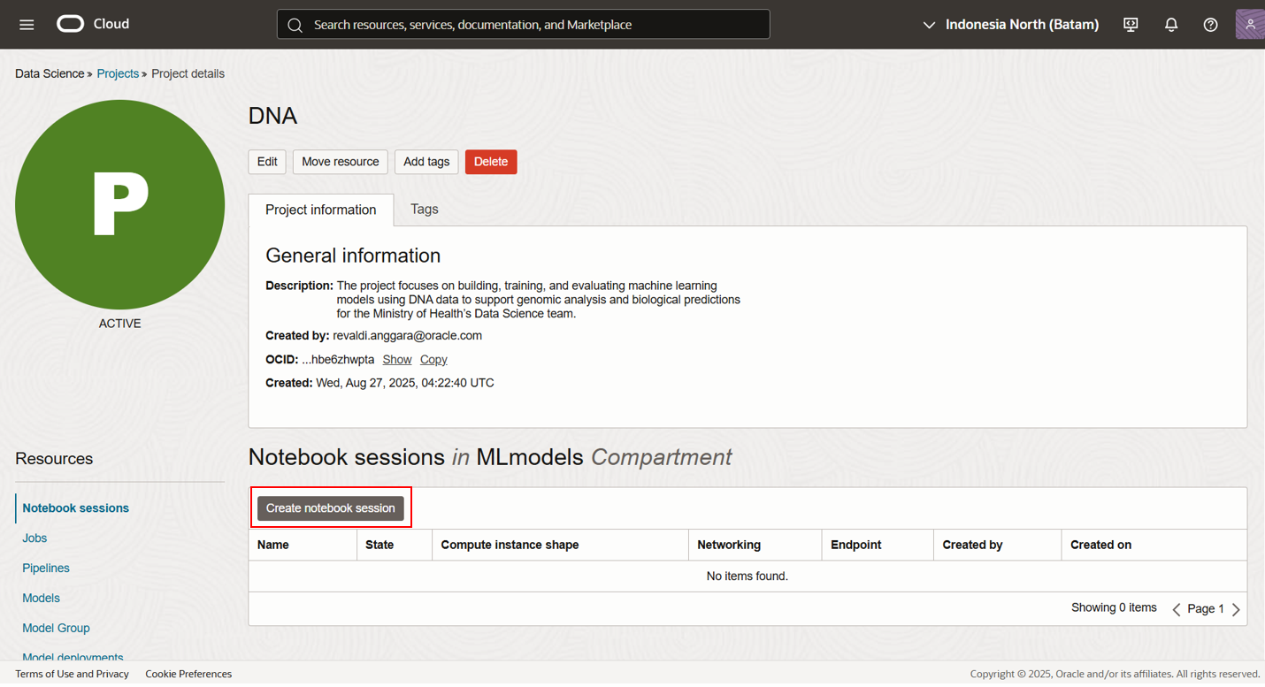
Create notebook session
Copyright © 2025, Oracle and KEMENKES - Confidential

Slide 7
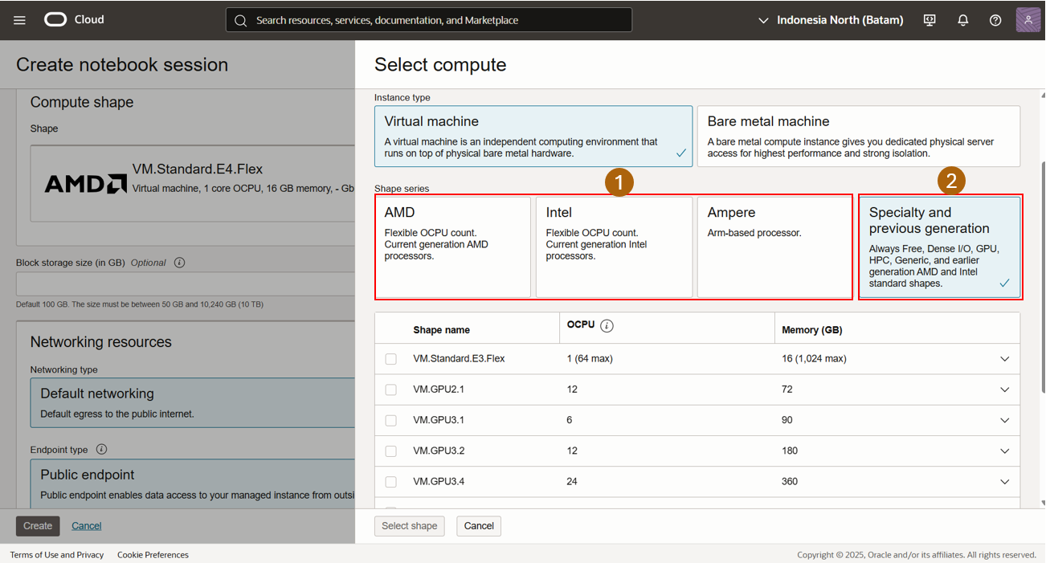
Notebook session dashboard for CPU & GPU. To use GPU, change the region to Japan Central (Osaka).

Slide 8
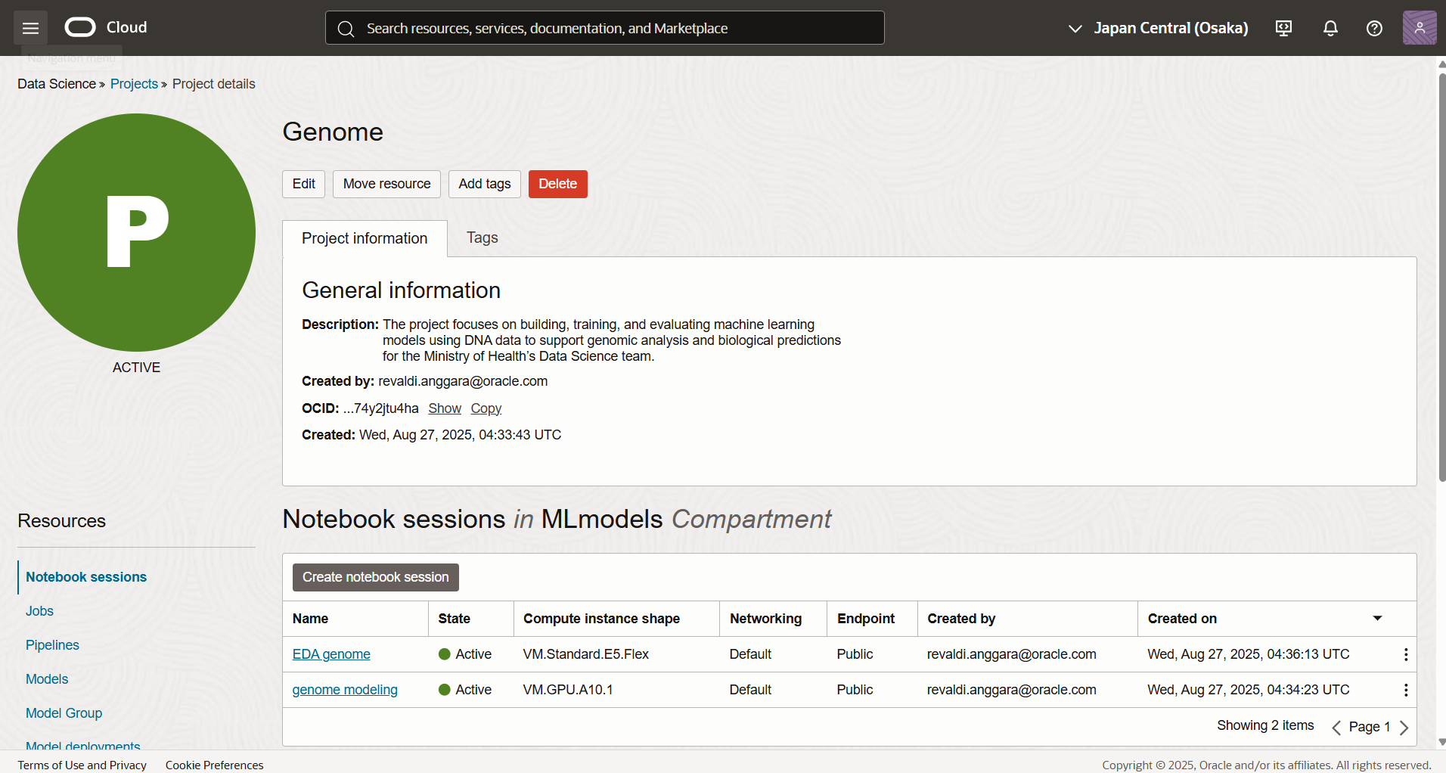

Slide 9
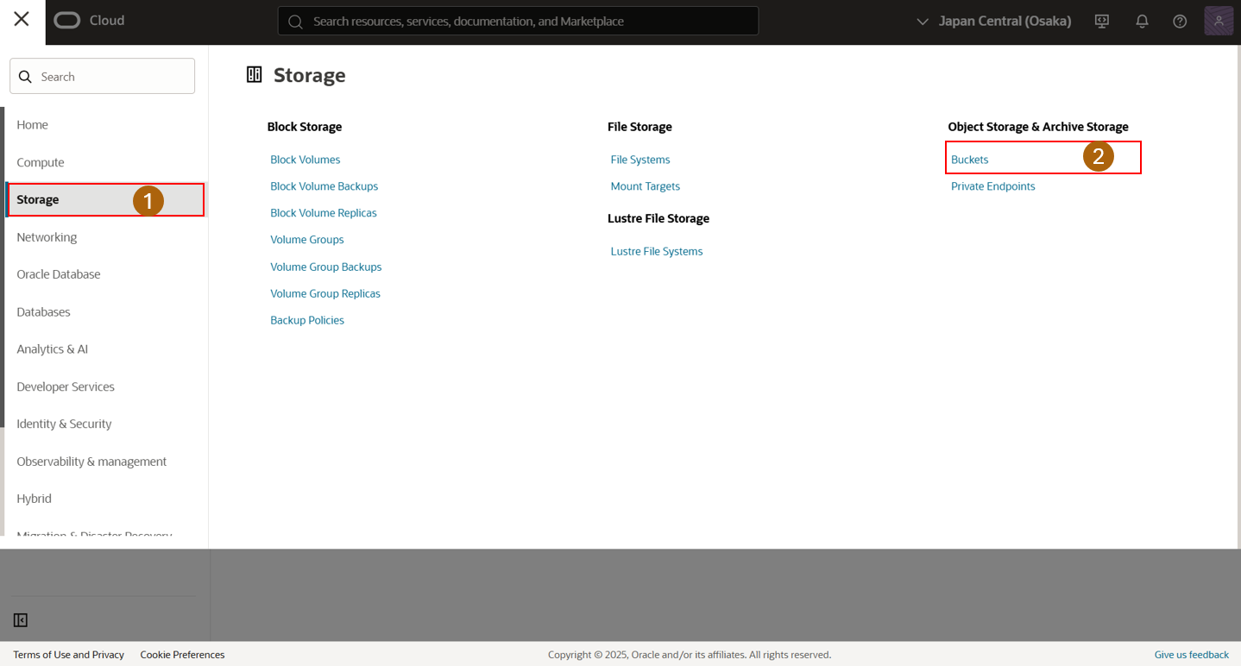
Select Storage
Select Buckets

Slide 10
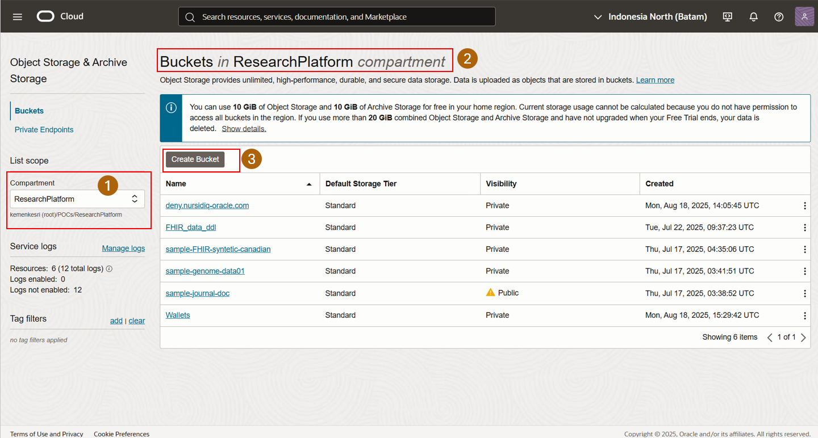
Choose Compartment
Make sure compartment is correct
Create Bucket

Slide 11
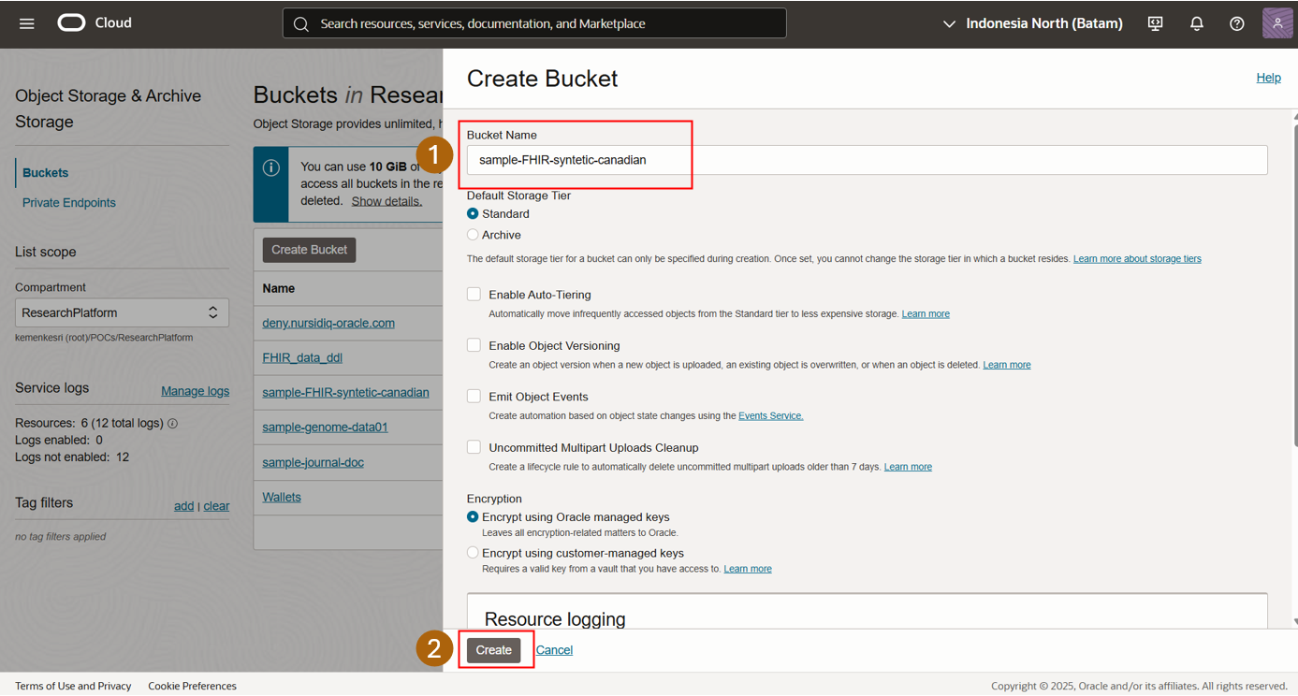
1
1. Enter a Bucket Name,
2. Click Create to finish creating the bucket.
2
Copyright © 2025, Oracle and KEMENKES - Confidential

Slide 12
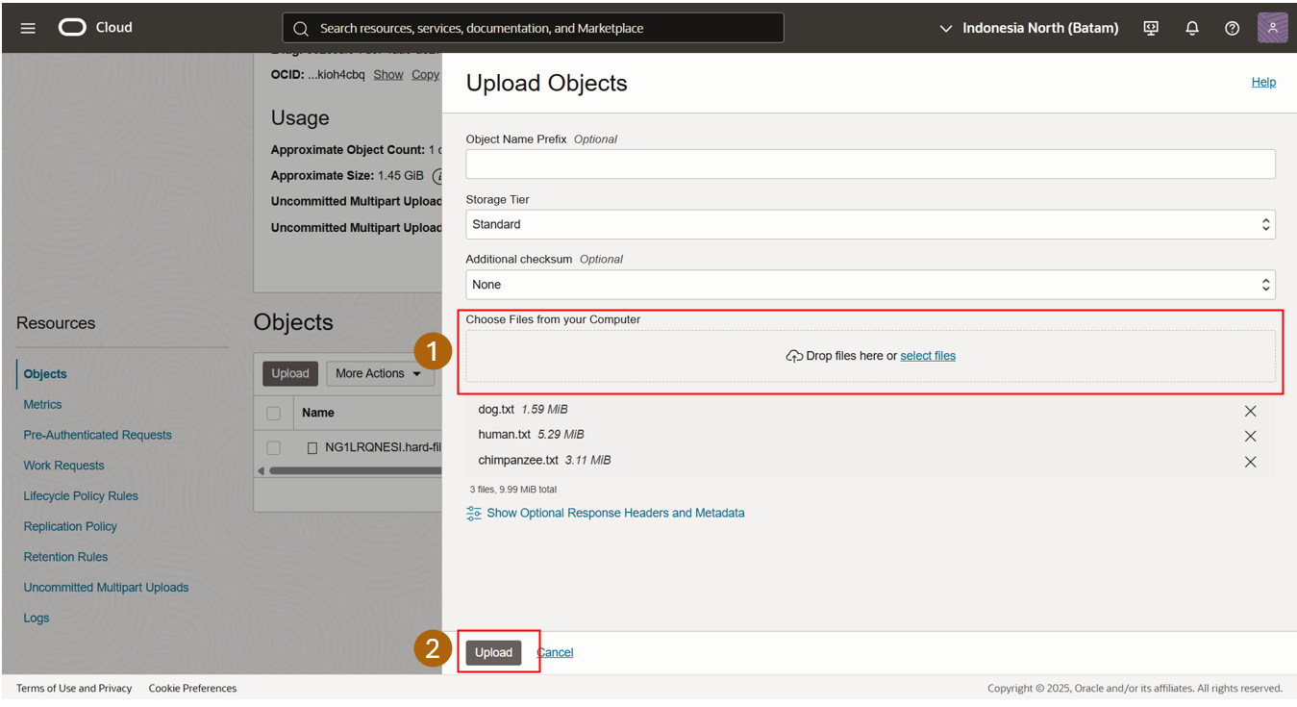
Select the newly created bucket,
Choose files from your computer and click Upload to add data.
1
2
Copyright © 2025, Oracle and KEMENKES - Confidential

Slide 13
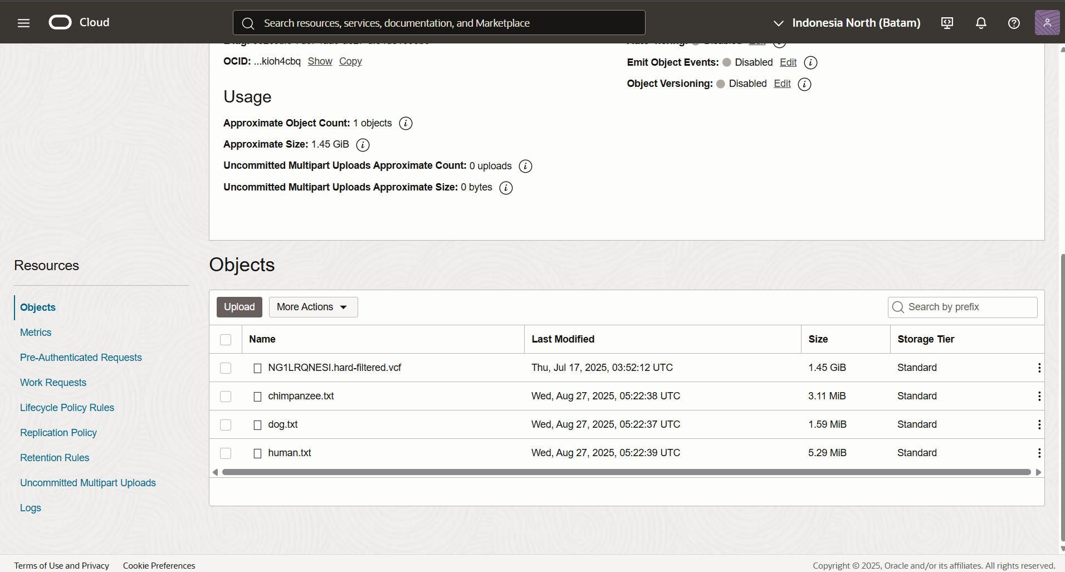

Slide 14
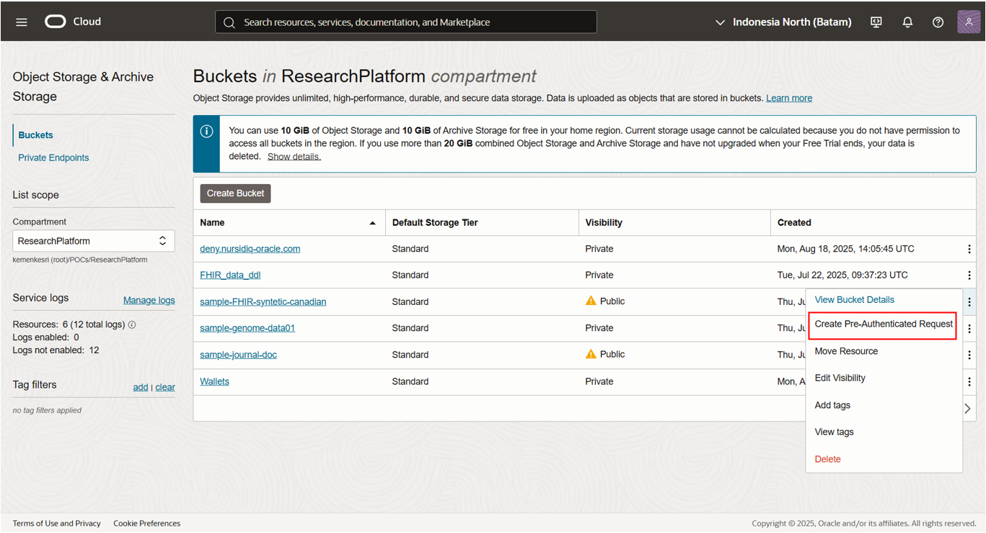
Go to the Buckets page in your selected compartment.
Locate the bucket you want to share or provide access to.
Click the three-dot menu (⋮) on the right side of the bucket.
Select Create Pre-Authenticated Request.

Slide 15
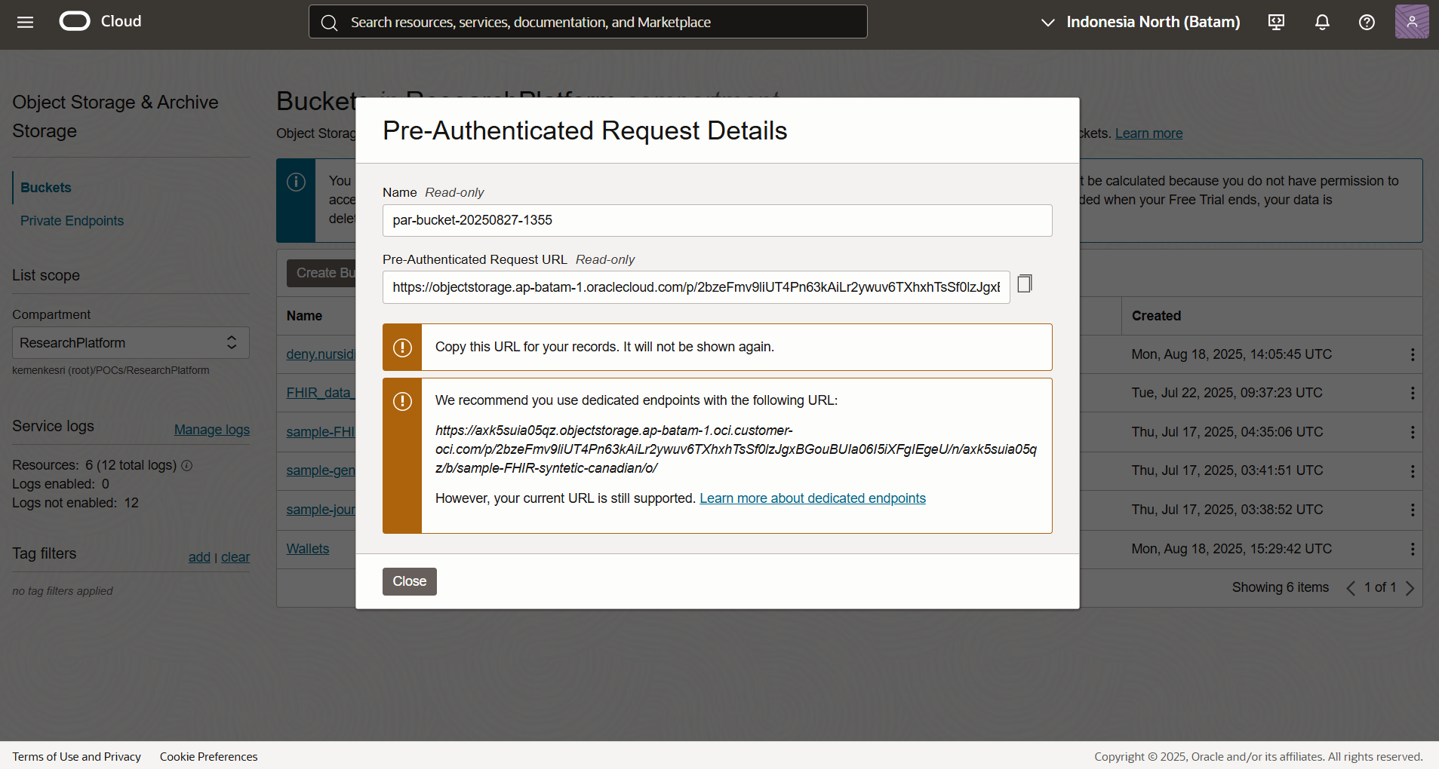
1. Copy the Pre-Authenticated Request (PAR) URL displayed in the dialog box.
Note: The URL will only be shown once, so make sure to save it.
2. Paste the PAR URL into your script in Oracle Data Science to access the object storage data.
3. Open Oracle Data Science to continue with your project setup and data processing.

Slide 16
import requests
import yaml
import logging
CONFIG_OBJECT_STORAGE = {
'base_par_url': https://objectstorage.ap-batam-1.oraclecloud.com/p/xyz/b/sample-genome-data01/o/,
'prefix': ""
}
base_par_url → This is the Pre-Authenticated Request (PAR) link generated from Object Storage. Use the URL you copied earlier.
prefix → Represents the folder name in Object Storage. Since Object Storage does not have a real folder structure, leave this as "" (empty string).

Slide 17
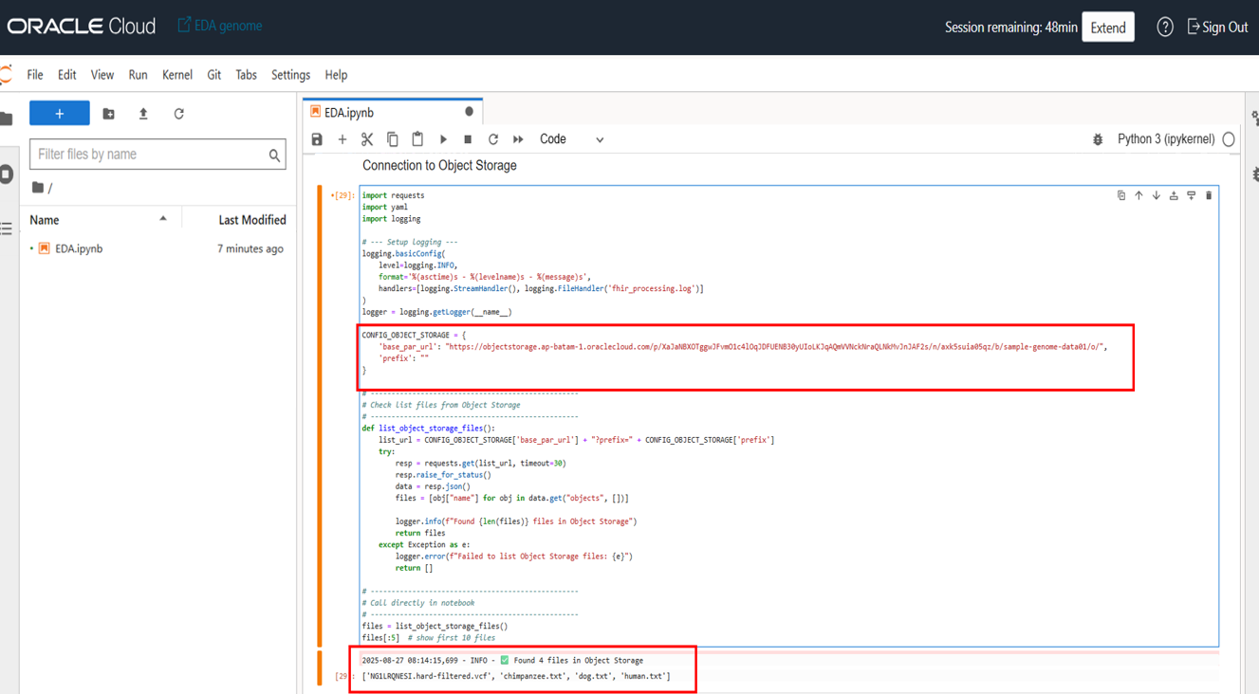
Setup PAR key in Oracle Data Science Notebook
If configured correctly, the script will read the data from Object Storage, confirming the PAR URL works and the connection is established.

Slide 18
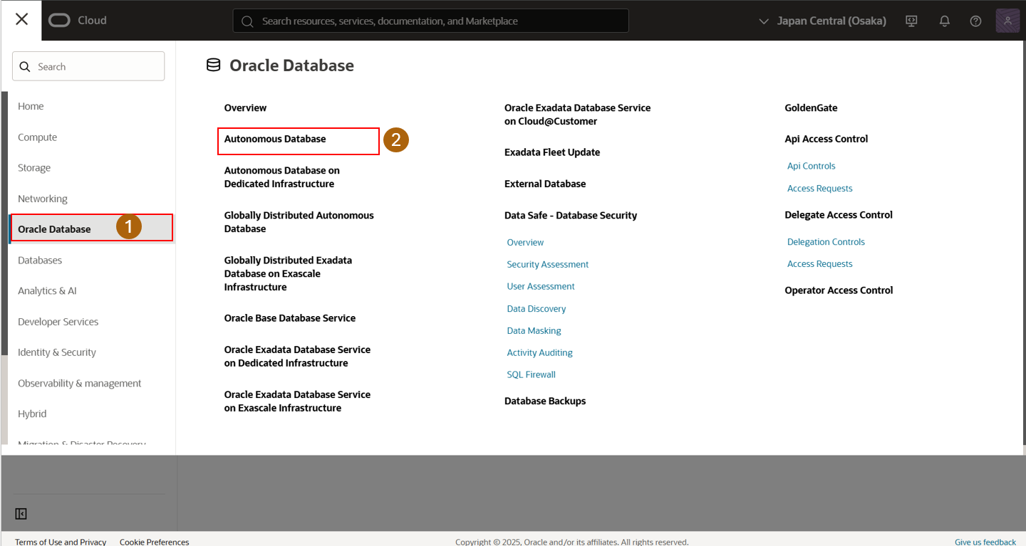
Select Oracle Database
Select Autonomus Database

Slide 19
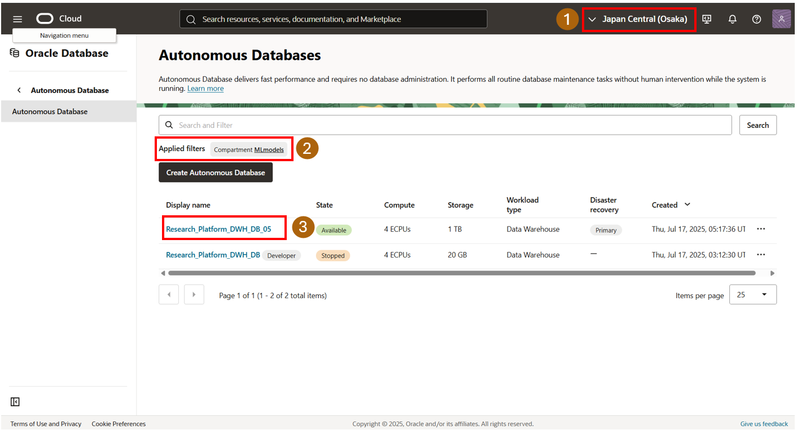
Change the region to Japan Central (Osaka).
Ensure the selected compartment is correct.
Assuming a database connection is already available, select Database.

Slide 20
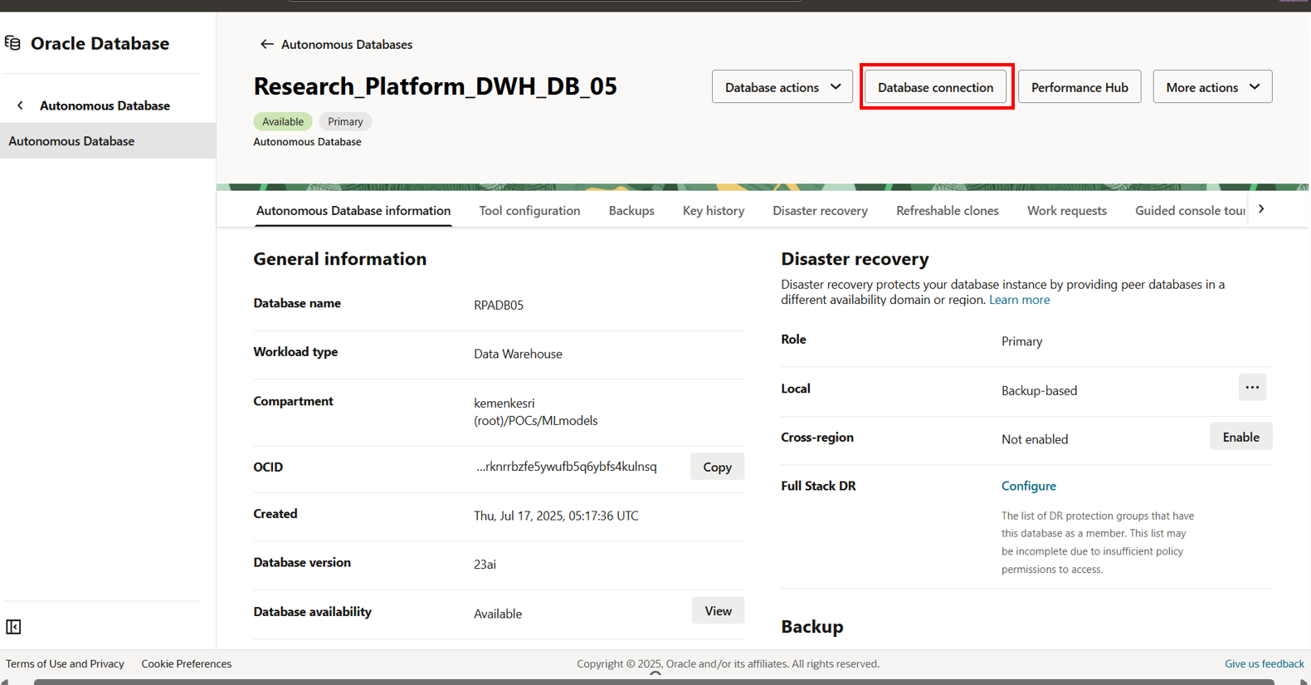

Slide 21
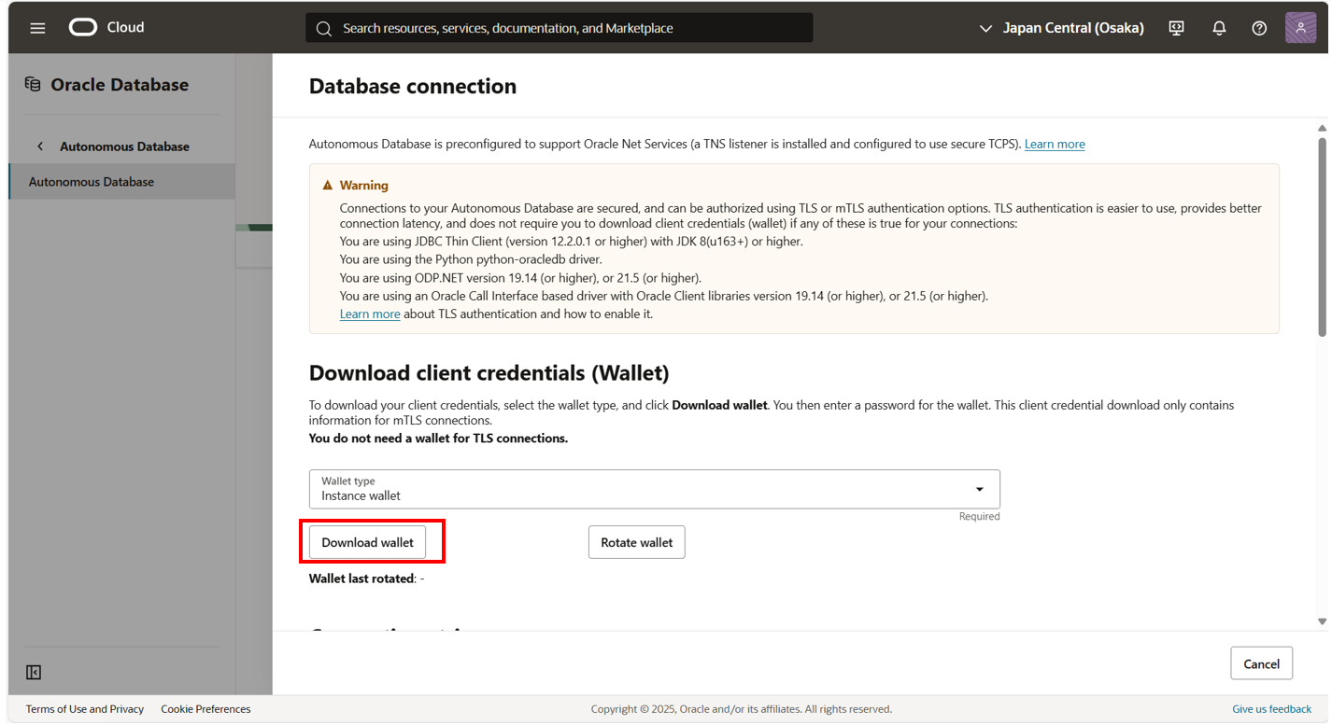

Slide 22
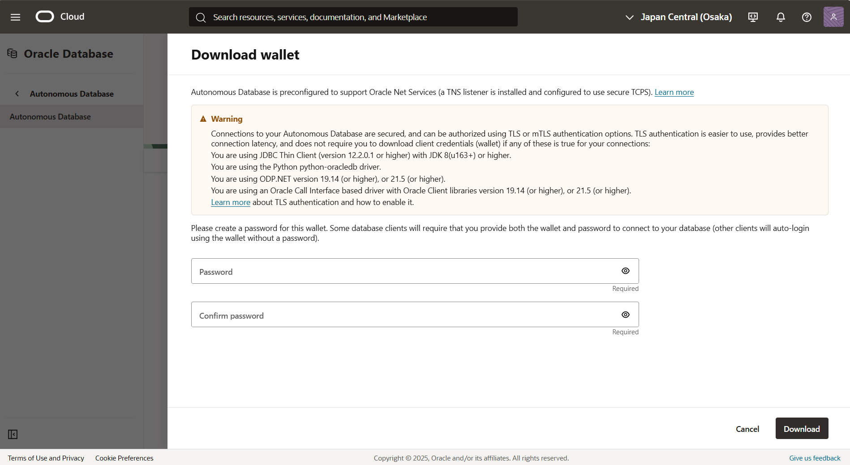
Set a password.
Note: This password will be required for the connection, so please remember and record it.
Save wallet into ODS.
Copyright © 2025, Oracle and KEMENKES - Confidential

Slide 23
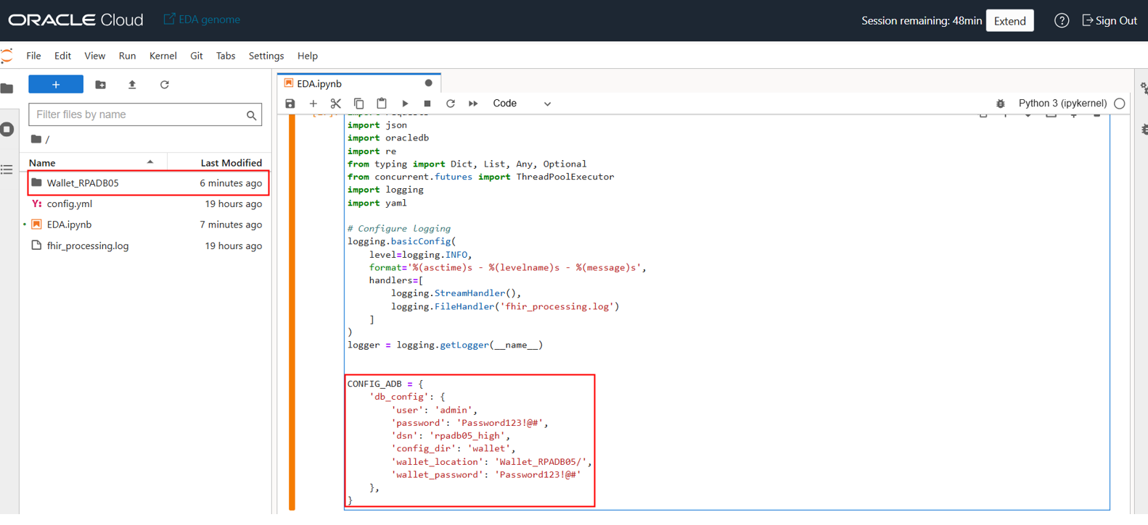

Slide 24
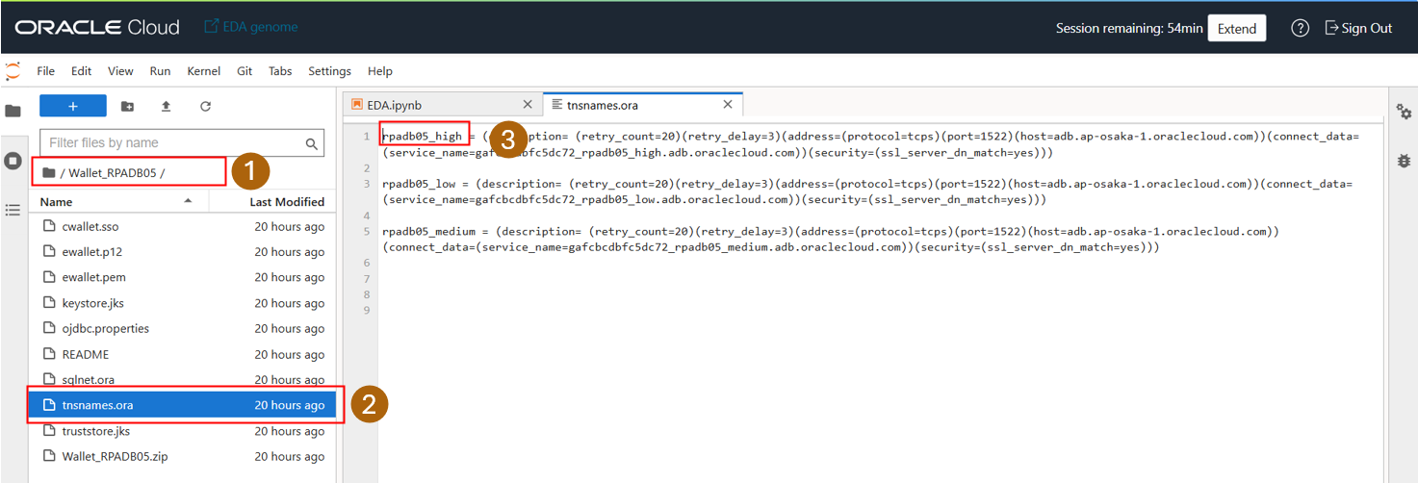
Open the Wallet folder.
Open the tnsnames.ora file.
Copy the variable with the suffix _high.

Slide 25
import requests
import requests
import json
import oracledb
import re
from typing import Dict, List, Any, Optional
from concurrent.futures import ThreadPoolExecutor
import logging
import yaml
# Configure logging
logging.basicConfig(
level=logging.INFO,
format='%(asctime)s - %(levelname)s - %(message)s',
handlers=[
logging.StreamHandler(),
logging.FileHandler('fhir_processing.log')
]
)
logger = logging.getLogger(__name__)
CONFIG_ADB = {
'db_config': {
'user': 'admin',
'password’: ‘xyz',
'dsn': 'rpadb05_high',
'config_dir': 'wallet',
'wallet_location': 'Wallet_RPADB05/',
'wallet_password': ‘xyz'
},
}
Database Connection Configuration
Wallet location → Path to the wallet in your project.
Wallet password → Password set when creating the wallet in the database connection.
User → Database username.
Password → Database user password.
DSN → Open Wallet_RPADB05/tnsnames.ora and use rpadb05_high.

Slide 26

Better care.
Better outcomes.
Better together.

Slide 27


